Slide 1
Regular Expressions

Slide 2
What are Regular Expressions?
A common task people need to perform is to find text in a document, like a name or date. Did “Clint” come to class last week on the attendance sheet? What do I have on my calendar for “December 3rd”?
Regular expressions are a way of describing a pattern of text so that a computer can easily find it. This allows computers to find text for us!
You use Regular expressions by creating a specially formatted string, where different symbols describe the pattern that the regular expression matches.
String contains a method for using Regular Expressions, matches();

Slide 3
Simple Examples
String s = “CSC 142”;
System.out.println(s.matches(“CSC 142”)); //True
System.out.println(s.matches(“MATH 42)); //False
System.out.println(s.matches(“CSC”));

Slide 4
Character Classes, Range
Instead of matching an exact string, you can match a range of characters using a character class. “[a][b]” is equivalent to “ab”. [abc] would match “a”, “b” or “c”;
This is powerful with the addition of ranges. Inside of character classes, a dash indicates a range. [a-z] would match any lowercase letter.
You can look for a repeated character or range of characters with {}.
[0-9][0-9][0-9] and [0-9]{3} are the same, and would both match any three digit number from 000 to 999.

Slide 5
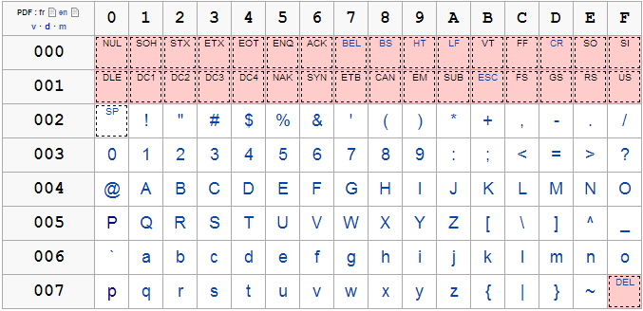
Table of values of chars
Match any Uppercase Letter: [A-Z]
Match any digit of number: [0-1]
Match any Lowercase Letter: [a-z]
Match any Symbol: [!-~]

Slide 6
Predefined Character Classes
Shortcuts for common Character Class ranges you might use:
. Any character (may or may not match line terminators)
\d A digit: [0-9]
\D A non-digit: [^0-9]
\s A whitespace character: [ \t\n\x0B\f\r]
\S A non-whitespace character: [^\s]
\w A word character: [a-zA-Z_0-9]
\W A non-word character: [^\w]
You will need to escape the “\” char, so to match a digit: s.matches(“\\d”);

Slide 7
Character Class and Ranges
String s = “CSC”;
System.out.println(s.matches(“[C][S][C]”)); //True
System.out.println(s.matches(“[C][S][B]”)); //False
System.out.println(s.matches(“[A-Z]{3}”)); //True
System.out.println(s.matches(“CS[A-Z]”)); //True

Slide 8
Example: Phone Number
String class1 = “555-554-3232”;
String class2 = “555-343-1233”;
String class3 = “a55-33d-3342”;
String class4 = “343-4423”;
How would we write a Regular Expression that matches class1 and class2, but not class3 or class4?

Slide 9
Example: CS Class at Seattle Central
String class1 = “555-554-3232”;
String class2 = “555-343-1233”;
String class3 = “a55-33d-3342”;
String class4 = “343-4423”;
String matchTel = “\\d{3}-\\d{3}-\\d{4}”;
System.out.println(class1.matches(matchTel)); //true
System.out.println(class2.matches(matchTel)); //true
System.out.println(class3.matches(matchTel)); //false
System.out.println(class4.matches(matchTel)); //false

Slide 10
Documentation
For more information about Regular Expressions, go to the Java API docs, “Patterns”
https://docs.oracle.com/javase/7/docs/api/java/util/regex/Pattern.html

